Slide 1
Assembly Language

Slide 2
Objectives
Students should be able to
Define the term assembly language
Explain what is an assembler
Describe a 2-pass assembler
Compare assembly language and machine code
Describe different addressing mode of assembly language
Outline the instruction set of assembly language

Slide 3

Review
Name two types of low-level programming language.
Name the only type of programming language that a CPU recognises.
Name 3 types of translation program
Why do programmers find writing in this type of programming language difficult?

Slide 4
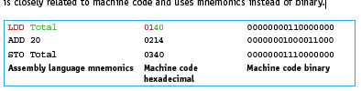
What is Assembly Language
Assembly Language is a low-level computer language where the commands are more closer to machine level language and equally understandable to human also.
The first programming language to be developed was assembly language, this is closely related to machine code and uses mnemonics instead of binary.
MOV, ADD, CALL, PUSH, NOT are examples of such commands.

Slide 5
Machine Code
What is machine code?
A low-level programming language consisting of binary digits/bits that the computer reads and understands.
Each instruction causes the CPU to perform a very specific task, such as a load, a store, a jump, or an arithmetic logic unit (ALU) operation on one or more units of data in the CPU's registers or memory.

Slide 6

Opcode and Operand
The structure of assembly language and machine code instructions is the same.
Each instruction has an opcode and an operand
The opcode (abbreviated from operation code is the portion of a machine language instruction that specifies the operation to be performed.
The operand is the part of the instruction which specifies what data is to be manipulated or operated on

Slide 7
Assembler
The Assembler is a translation software/program that converts an assembly language code to machine code.
It takes basic assembly language computer commands and converts them into Binary Code that Computer's Processor can use to perform its Basic Operations.
The language written in Assembly language is called the source code and the one translated into machine code is called the “object code”
An assembler also checks the syntax of the assembly language program to ensure that only opcodes from the appropriate machine code instruction set are used.
This speeds up the development time, as some errors are identified during translation before the program is executed.

Slide 8
Types of Assembler
There are two(2) types of assembler –
One Pass Assembler. These assemblers perform the whole conversion of assembly code to machine code in one go.
Two Pass Assembler. These assemblers first process the assembly code and store values in the opcode table and symbol table. And then in the second step, they generate the machine code using these tables.

Slide 9
A Two Pass Assembler
Two pass translations consist of pass I and pass II.
The assembler scans the code twice.
The first time, just count how long the machine code instructions will be, just to find out the addresses of all the labels. A symbol table is created which is a table that has a list of all the addresses and where they will be in the program.
On the second scan, it generates the machine code making use of the symbol table. In this pass the object code generated is stored so that it can be loaded then executed at a later stage. The loader does this.

Slide 10
Summary
Pass 1
Read the assembly language program one line at a time.
Ignore anything not required, such as comments.
Allocate a memory address for the line of code.
Check the opcode is in the instruction set.
Add any new labels to the symbol table with the address, if known.
Place address of labelled instruction in the symbol table.
Pass 2
Read the assembly language program one line at a time.
Generate object code, including opcode and operand, from the symbol table generated in Pass 1.
Save or execute the program.
The second pass is required as some labels may be referred to before their address is known.

Slide 11
The Assembler Process
Some Important Terms
Opcode table: They store the value of mnemonics and their corresponding numeric values.
Symbol table: They store the value of programming language symbols used by the programmer, and their corresponding numeric values.
Location Counter: It stores the address of the location where the current instruction will be stored.

Slide 12
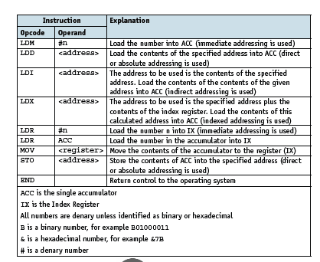
Assembly Language instruction code
There are different types of assembly language instructions.
Data movement instructions
These instructions allow data stored at one location to be copied into the accumulator.
This data can then be stored at another location, used in a calculation, used for a comparison or output.

Slide 13
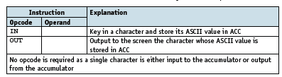
Assembly Language instruction code
Input and output of data instructions
These instructions allow data to be read from the keyboard or output to the screen.

Slide 14
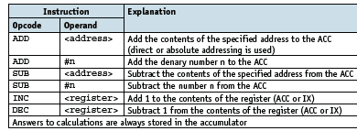
Assembly Language instruction code
Arithmetic operation instructions
These instructions perform simple calculations on data stored in the accumulator
and store the answer in the accumulator, overwriting the original data.

Slide 15
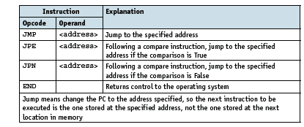
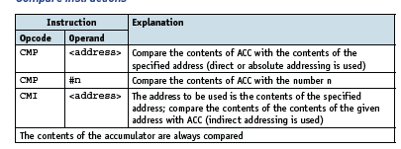
Assembly Language instruction code
Unconditional and conditional instructions
Compare instructions

Slide 16
Addressing modes
Direct /Absolute addressing – the contents of the memory location in the operand are used.
Indirect addressing – the contents of the contents of the memory location in the operand are used.
Indexed addressing – the contents of the memory location found by adding the contents of the index register (IR) to the address of the memory location in the operand are used.
Immediate addressing – the value of the operand only is used..
Relative addressing – the memory address used is the current memory address added to the operand.
Symbolic addressing – only used in assembly language programming. A label is used instead of a value.

Slide 17
CIE Exam Requirements
All questions will assume there is only one general purpose register available (Accumulator)
ACC denotes Accumulator
IX denotes Index Register
<address> can be an absolute or symbolic address
# denotes a denary number, e.g., #123
B denotes a binary number, e.g. B01001010
& denotes a hexadecimal number, e.g., &4

